Slide 1
Welcome to Year 1

Slide 2
Which members of staff will teach my child?
Teachers- Mrs Main and Miss Costall
Mrs Main will be the class teacher from Monday through to Wednesday morning.
Miss Costall will be the class teacher from Wednesday afternoon through to Friday.
Teaching assistant: Mrs Willis

Slide 3
How does the curriculum change in year 1 ?
In Reception (EYFS), learning is mostly child-led, open-ended, and focused on personal, social, and physical growth through play.
When children enter Year 1, the curriculum changes in a few major ways:
Subject-based learning: Instead of broad areas of development, learning is divided into distinct subjects like English, Maths, Science, and Geography.
Adult-directed tasks: The teacher sets specific learning targets that all children work on.
More recording: Children begin to record their work more formally in exercise books rather than just having photos taken of their play.

Slide 4
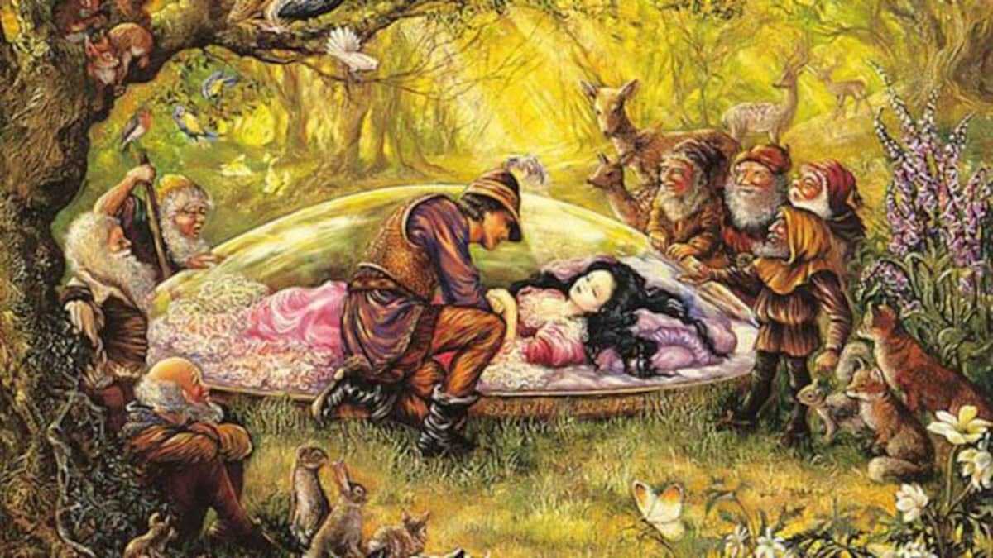
What topics will your child learn?
Autumn1: All About Me
Autumn 2: Fascinating toys
Spring 1: Traditional tales
Spring 2: Whacky weather
Summer 1: Wonderful woodlands
Summer 2: The seaside

Slide 5
Reading:
To help keep track of the new routine, here is a quick summary of the schedule:
Reading target: At least 4 times every week.
Journal duty: Write down every time you read, and clearly mark when a book is finished.
Book change days: Monday and Friday (make sure the reading scheme books are in their bag on these days!).
Library books:
Library visits: Are on Monday. Children will come home with their new library book. Children can change their library book every Monday.

Slide 6
Phonics:
What Your Child Will Learn in Phase 5
New Sound Spellings (Graphemes): They will learn new letter combinations for sounds they already know, like ou as in cloud, ie as in pie, and ea as in sea.
Split Digraphs: They will learn about "friendly" letters that work together to make one sound even when a letter sits between them (like the i-e in time or the o-e in home).
Alternative Pronunciations: They will learn that the same letters can say different things. For example, ow makes a different sound in snow than it does in cow.
Tricky Words: These are words that cannot be sounded out easily using normal rules. Examples in Phase 5 include people, their, looked, called, and could.

Slide 7
Phonics screening test:
The Phonics Screening Check takes place in June. It is not a formal, stressful exam. It is a quick, one-on-one reading check with their teacher to ensure they are on track with their decoding skills.
The Format: Your child will read 40 words aloud to their teacher.
Real vs. "Alien" Words: Half of the words will be real words, and half will be made-up nonsense words (often shown with a picture of a little alien).
Why Alien Words? Nonsense words like vrob or strayb ensure children are actually using their phonic sounds to blend letters together, rather than just guessing a word they have memorized.
The Result: You will get their score in their summer school report. If a child needs a bit of extra help, they simply repeat the check in Year 2.

Slide 8
Phonics at home:
Practice: Please practice the weekly sound found on the bookmark inside your child’s reading journal.
Be a Sound Detective: When reading their school book, look for the weekly sound. Ask, "Can you find any words on this page that have our special sound of the week?"
Spot the Tricky Words: Write the week's tricky words on sticky notes. Hide them around the room and have your child hunt for them and read them aloud.
Play "Real or Alien": Write down a few real words and a few made-up words using their weekly sound on pieces of paper. Have your child sort them into a "treasure pile" (real) or a "rubbish bin" (alien). You can also play interactive versions of these games on educational sites like PhonicsPlay.

Slide 9
PE:
PE Kit Checklist
Please pack these items in a labeled bag:
PE T-shirt
Shorts
Trousers (great for colder days outside)
Spare socks
Spare underwear
Quick Tips for Success
Label Everything: Write your child's name on the tags of all their clothes so they do not get lost.
Practice at Home: Since the school wants children to dress themselves, turn it into a fun game at home! You can race to see how fast they can put on their socks or button their shirt.
Easy Clothes: Choose trousers with elastic waistbands and shoes with Velcro instead of laces to make changing much easier for little hands.
End-of-Term Wash: You won't need to take the kit home every week. The school will send it back at the end of the term for a good wash.

